Slide 1
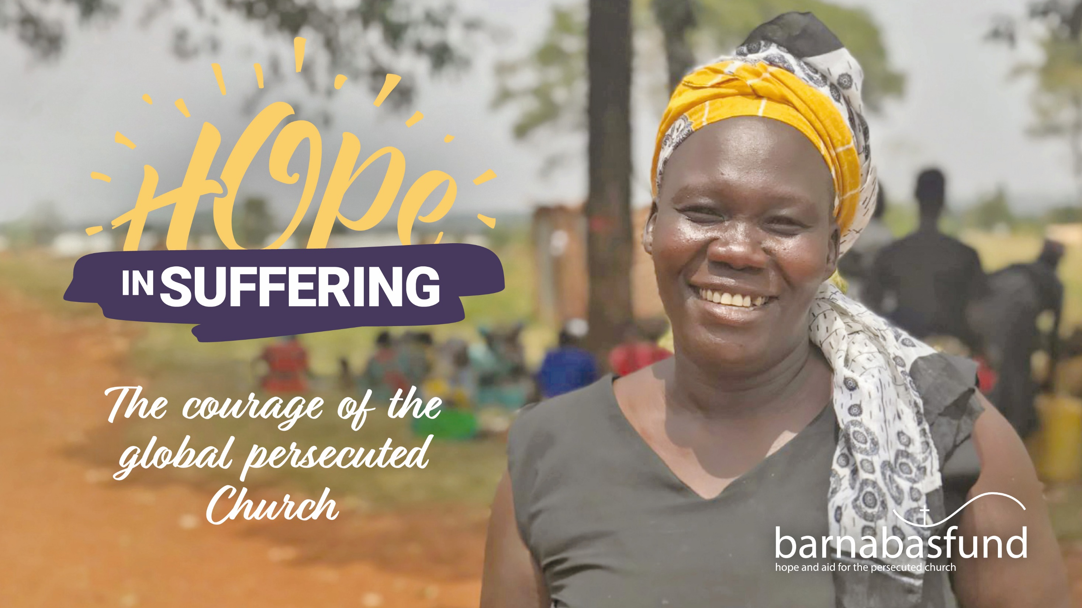

Slide 2
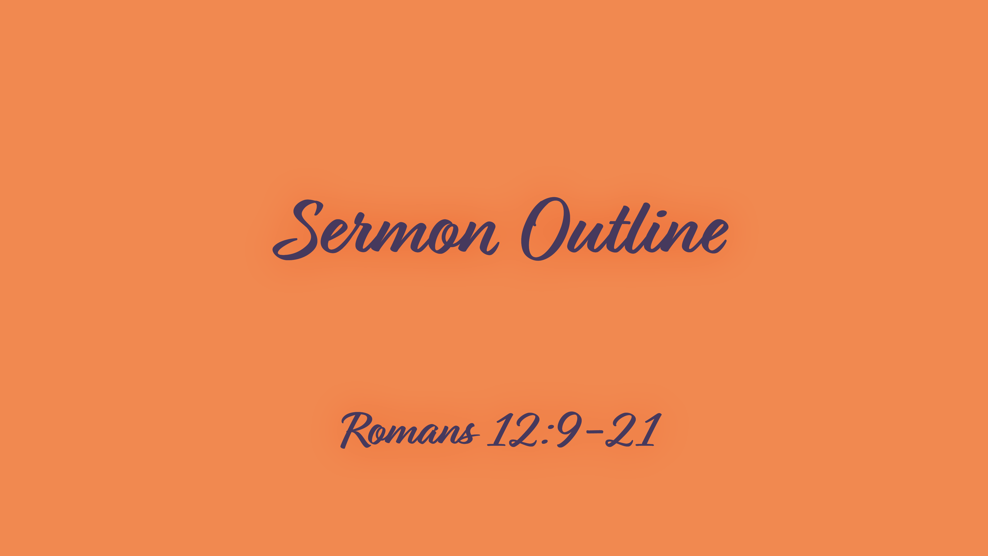

Slide 3

Hope and suffering are two constant realities in the Christian life. Suffering in this earthly life is a reality of Christian experience, and hope in our eternal heavenly home is a reality of Christian faith.

Slide 4
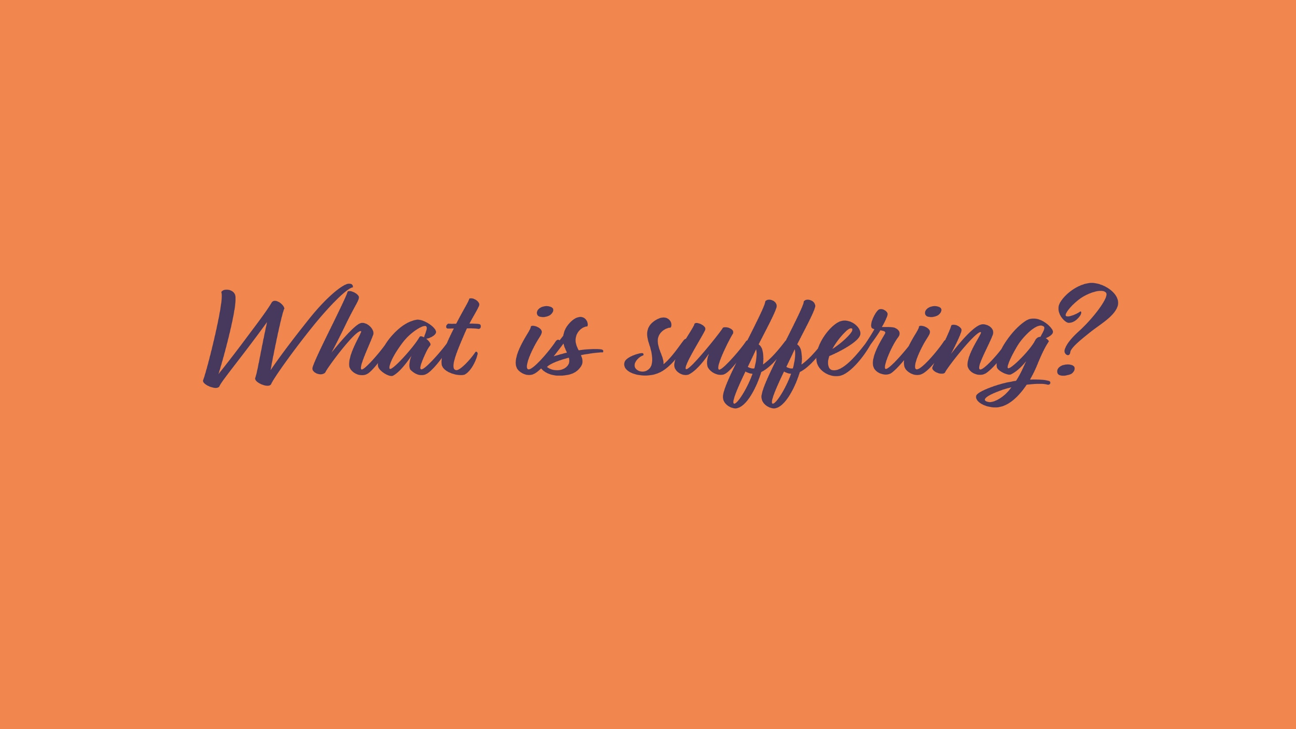

Slide 5
1 Pressure
In Romans 12:12, Paul uses the word thlipsis, trans. “tribulation”
Derived from crush, compress, squeeze or break
Not mild discomfort, but great, crushing difficulties
As a heavy weight on chest pressing the very life from us

Slide 6
2 Persecution
Persecution normal for early Christians, scars badges of honour
Persecutors or diokontas (v.14) hunted down Christians
Such persecution normal for many Christians around world today
They know they say goodbye to earthly comfort and security when they decide to follow Jesus
Even without persecution, disciples of Christ are misfits in mainstream society
If we don’t feel a bit alien and out of place in the world are we really following Christ?

Slide 7
3 Pain
Suffering can bring pain and weeping (v.15)
Not everyone is persecuted but physical, mental and emotional pain is common to human existence
This year Covid-19 traversed the whole planet causing sickness, death, loss of livelihoods, fear and anxiety on a global scale. Adding to the suffering of us all.

Slide 8
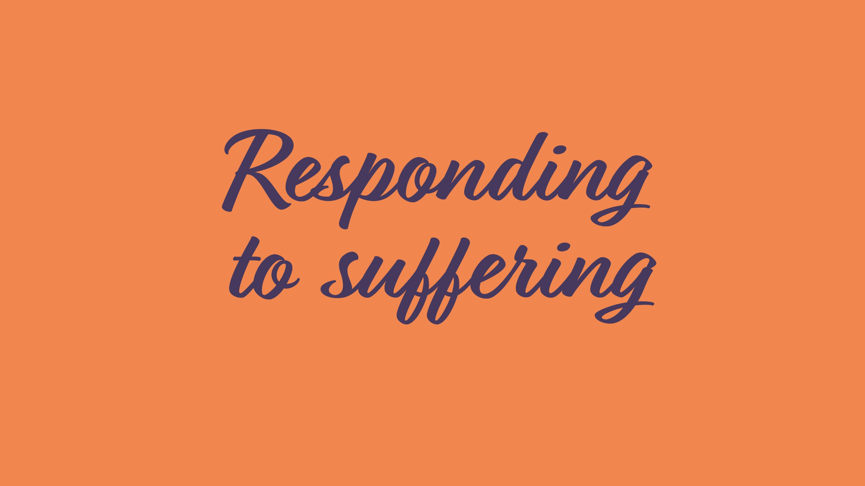

Slide 9
1 Love: sincerity of love v.9
Love is central to Christian life
Our love must be genuine: with no playacting or ulterior motive

Slide 10
1 Love: goodness of love v.9
We must love what is good
Which comes with an intense hatred of evil
As we turn in revulsion from evil we must turn to what is good: morally, spiritually and savingly
We hold firmly to it as if superglued to it

Slide 11
1 Love: family basis of love v.10
Paul uses a word in v.10 found nowhere else in New Testament: philostorgos
This is a deep, tender, heartfelt affection that close relatives naturally have for one another
Philostorgos also carries idea that love is shown in practical acts of generosity

Slide 12
1 Love: honouring each other in love v.10
Not only must we love one another, we must honour one another
Paul says strive to be the first to honour another believer who deserves it
As if trying to outdo each other in showing respect and esteem

Slide 13
1 Love: love for enemies v.10
Not only must we love one another, we must honour one another
Paul says strive to be the first to honour another believer who deserves it
As if trying to outdo each other in showing respect and esteem

Slide 14
2 Hope v.12
Paul commands us to rejoice in hope
“Hope” has a specific meaning in the Bible: used objectively to mean a situation for which we hope
The fulfilment of all God’s promises is salvation, when we shall be free of the unsatisfied needs and wants of this life, and from sin
“Hope” also used subjectively in the Bible to mean the confident assurance and sure expectation of these things God has promised will be ours
But how can we rejoice in hope during suffering or tribulation?

Slide 15
2 Hope: character
We can rejoice in our sufferings because of the fruit of that will be produced in our characters (Romans 5:4)

Slide 16
2 Hope: counted worthy
The apostles rejoiced that they had been counted worthy to be disgraced for Christ (Acts 5:41)
Through all the centuries believers have rejoiced in the honour of suffering for their Lord

Slide 17
2 Hope: Christ
In his letter to the Philippians, Paul (who was a prisoner at the time) commanded, “Rejoice in the Lord always”
Whatever our outward circumstances, when we turn our thoughts to Jesus, how much cause there is to fill our hearts with joy

Slide 18
3 Patience
Paul writes that we must be “patient”
This is a positive and active response, not passive endurance
It is “brave patience”
Perseveres in bearing the load, whatever it is
Refuses to weaken, complain or be discouraged
Refuses to try to slip out from under the load

Slide 19
4 Prayer
How can we find the strength to bear our afflictions like this?
The number one answer is prayer
Prayer is the refuge and resource of every Christian in times of suffering
We must be faithful, steadfast and constant in prayer, both with others and on our own

Slide 20
5 Service: be zealous v.11
There is no room for lethargy in Christian life
The world is a battleground between good and evil
Our short earthly lives are a preparation for eternity
We must be diligent and zealous

Slide 21
5 Service: be aglow with the Spirit v.11
“Aglow” (or “Spiritual fervour” in some translations) are muted versions of what Paul actually wrote
He says in v.11 we should be spiritually boiling!

Slide 22
5 Service: serve the Lord v.11
Verse 11 finished with a command:
Literally reads: “As regards the Lord – slaving.”
The key thing about “slaving” in the first century was that everything done was directed by the master’s will
As Christians we are all slaves of Christ our Master
We must do His will in everything

Slide 23
5 Service: generosity v.13
“Share with God’s people who are in need,” commands Paul
Literal translation: “As regards the needs of the saints – fellowshipping!”
Uses a version of the word koinonia that Paul wrote to mean a practical financial contribution
Koinonia is often used in the New Testament to indicate other kinds of sharing and participation
The word “fellowship” is often used in 21st century churches to mean a congregation getting together for a cup of tea after Sunday service
But Paul saw fellowship as including practical help for needy believers

Slide 24
5 Service: hospitality v.13
Paul moved on to giving hospitality to needy Christians
It was a kind of hospitality Christians in Rome knew well – the hospitality offered to fellow believers
Offered to all including travelling preachers, messengers, or those fleeing anti-Christian persecution, some of whom were destitute
As strangers and pilgrims in a hostile world, 1st century Christians had to care for each other
It is still necessary today as Christians in many parts of the world are fleeing persecution and are in desperate need

Slide 25
5 Service: hospitality v.13
When militants attacked the Christian village of Hura in Plateau State, Nigeria, on 14 April it was already hosting survivors form other attacks on communities nearby
Each household in Hura therefore numbered between 17 and 26 people
28 Homes in Hura were burnt, making hundreds of Christians homeless, many for a second time
After burying their dead, the villagers and their visitors fled to a nearby town to seek refuge

Slide 26
6 Empathy v.15
Paul tells us to rejoice with those who rejoice and to weep with those who weep
Our tears bring great comfort to the suffering one
Christians should not ne people who shrink from the pain of empathy with those who are suffering

Slide 27


Slide 28
Conclusion
As we have see, Christians must endure their persecution and suffering with patience
This does not mean there will be no justice, that wrongs remain unrighted and cruelty will always be triumphant
God Himself will act. We can place all the injuries and injustices we suffer in the hands of the Judge of all the earth (Genesis 18:25)
What a relief to pass over to Him that responsibility, for He alone knows all the circumstances, past and present
He knows the deepest thoughts and intentions of each heart
God can judge more justly than we ever can

Slide 29
Conclusion
In verse 19, Paul writes of God’s wrath, and quotes the Lord’s words:
“It is mine to avenge; I will repay.” (Deuteronomy 32:35)
We must step aside and not presumptuously interfere as He deals out his perfect justice om His perfect time

Slide 30
Conclusion
Finally, in verse 21, Paul hold out to us a glorious prospect
If we continue rejoicing, loving, forgiving and hoping, then evil has not conquered us – no matter how great our suffering
And, if we respond with good, we can conquer evil itself

